Slide 1

Adenylate Kinase
Various forms and role in cellular energy homeostasis
University of Delhi, 2023

Slide 2

Introduction
Adenylate kinase (AK, ATP:AMP phosphotransferase or more commonly Myokinase) is present in almost all eukaryotes (IMS of mitochondria) and prokaryotes (in cytoplasm & periplasm).
It catalyzes transfer of phosphate group from a high energy doner to an acceptor substrate in a process called Phosphorylation. In case of kinase catalyzed reactions, high energy phosphate doner is usually ATP.
Mg²⁺.ATP + AMP $\begin{matrix}AK \\ ⇌ \\ \end{matrix}$ Mg²⁺.ADP + ADP
AK plays a crucial role in regulating and balancing production and expenditure of cellular energy by monitoring levels of ATP, ADP and AMP inside cell and thus helps in achieving homeostasis.

Slide 3
Structure
and Mechanism
Domains and Binding Sites
Conformational Mechanism
Inhibition Testing
MD simulations

Slide 4
Structure of AK
AK in human is composed of 194 amino acid residues with molecular weight ∼22kDa. Bacterial AK is made up of ∼210-220 amino acids.
Human AK is a globular protein composed of three domains – CORE, LID and Nucleoside Monophosphate (NMP) substrate binding region.
CORE contains glycine rich region where phosphate doner binds called P-loop. It consists of 6 β-strands and 6 α-helices.
The surface loop region (LID and NMP) connects the β-strands and α-helices of CORE and contains ATP & AMP binding sites.
CORE is conformationally unaffected during enzymatic action of AK, while the surface loop region is highly flexible and undergoes significant conformational changes upon substrate binding, triggering the catalytic activity of enzyme.
The ATP binding site is situated between CORE and LID domains (near N-terminal) and the AMP site is located between CORE and AMP (near C-terminal).

Slide 5
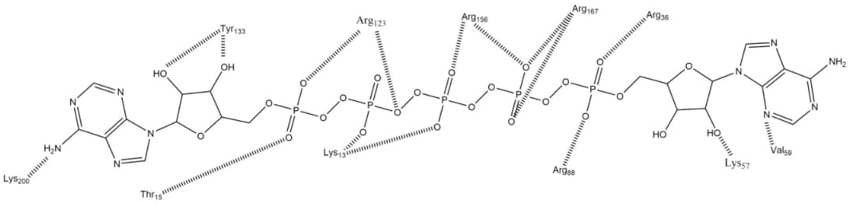
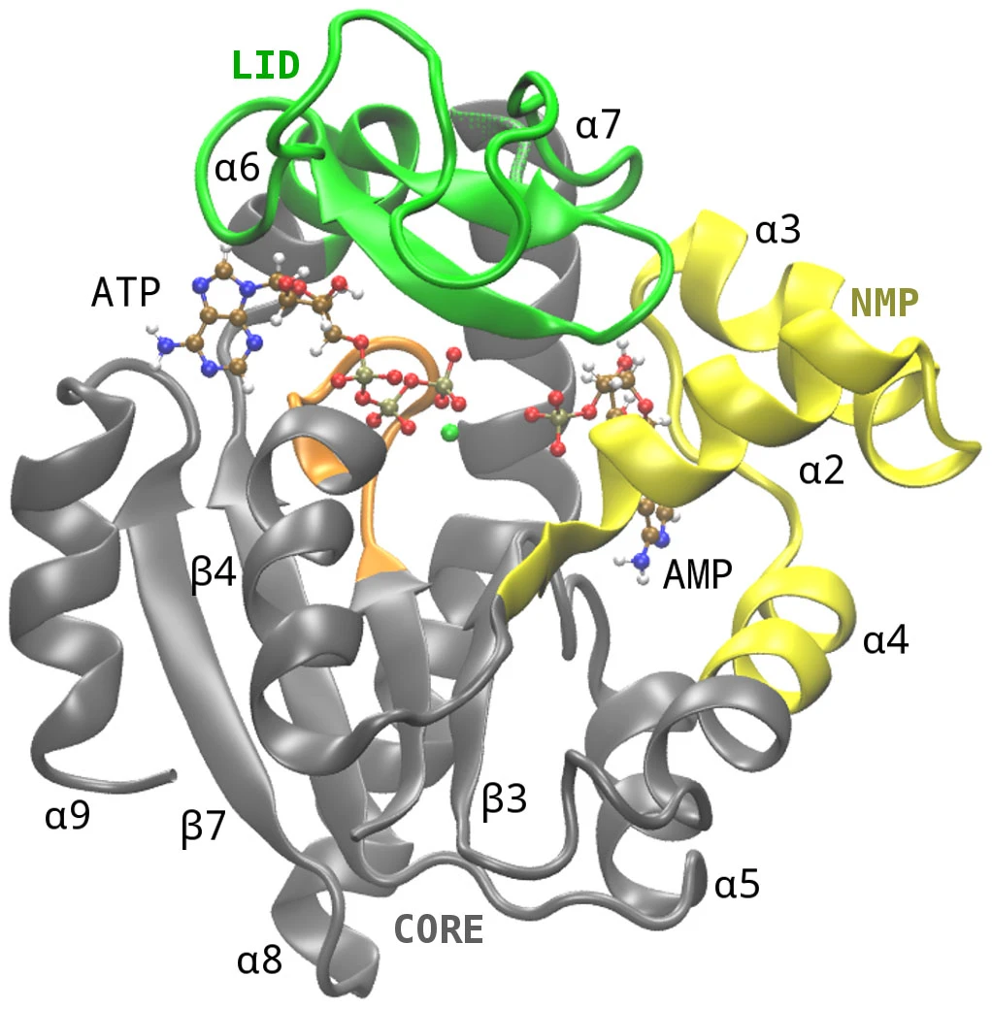
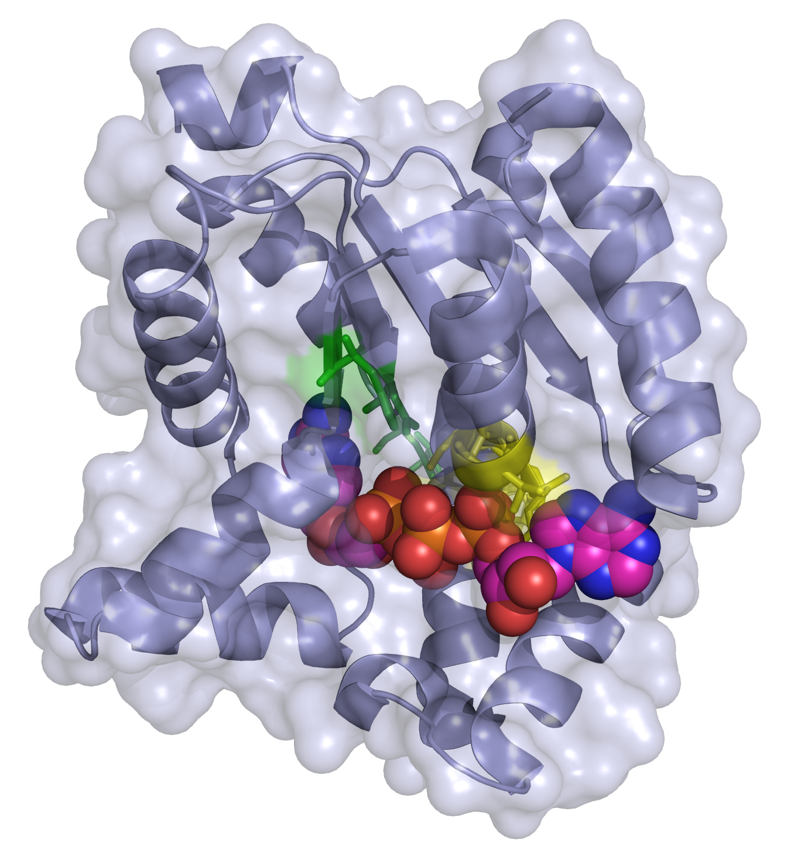
(a) Residue of AK in Escherichia coli involved in substrate binding
(b) AK bound to ATP and AMP
CORE (1-29,68-117,161-214) – Gray
LID (118-160) – Green
NMP (30-67) – Yellow
P-loop (7-13) – Orange
(c) 3D Ribbon model of AK complexed with 2ADP
Active center – Yellow
ATP binding site – Green

Slide 6
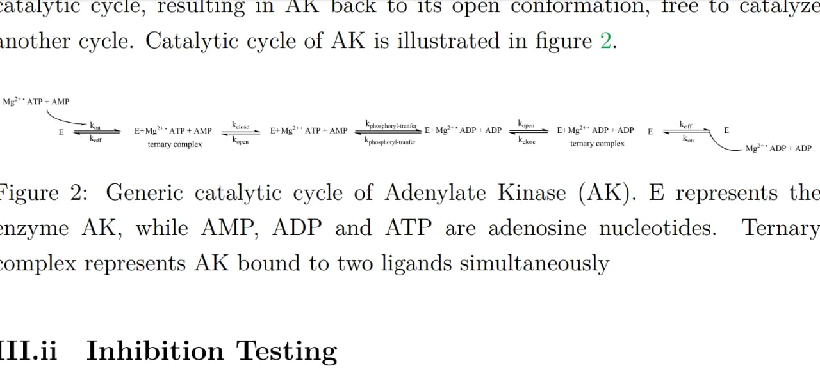
Mechanism of AK
In absence of any bound ligand, enzyme is in unligated ‘open’ conformation. As Mg²⁺ complexed phosphate doner binds with enzyme, it triggers closing of open surface loop of LID, which signals NMP binding site to close with substrate bound within the pocket. Thus AK adopts ‘closed’ conformation.
In closed state, AK globular structure shrinks, causing water molecules to expel from enzymatic cavity, which brings the substrate in proximity with phosphate doner.
Presence of Mg²⁺ increases electrophilicity of ATP resulting in migration of γ-phosphate from ATP to AMP.
Phosphate transfer triggers LID and NMP to open up releasing the ADP molecules. This marks completion of one catalytic cycle resulting in AK back to its ‘open’ conformation.

Slide 7
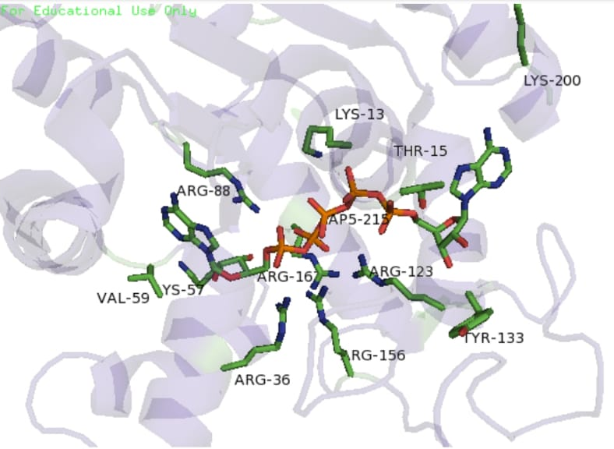
Inhibition Testing
Crystal structure of AK from E. coli with AP5A [ P1,P5-Di(adenosine-5') pentaphosphate] inhibitor shows that AP5A binds with Arg88 at α-phosphate group. This inhibition results 99% loss of catalytic activity suggesting Arg88 plays crucial role in phosphoryl transfer reaction.
Another residue in CORE domain that remains highly conserved across species is Arg119, located at adenosine binding region of AK and binds with Adenine within active site.
Other conserved residues are Lys113, Arg123, Arg156 and Arg167 which form a network of positive amino acids which stabilizes accumulation of negative charge on phosphoryl group during the transfer.
This lysine-arginine network is also bound by two distal aspartate residues that causes the enzyme to fold and lose flexibility.
Key residue in AK of E. coli crystallized with AP5A inhibitor

Slide 8
MD Simulation
Conformational sampling of AK can be done using ∼1μs metadynamic sampling rate, which allows for collective motion of X-ray structural functions of AK to be simulated in 1μs-ms timescale.
From MD simulation of X-ray structure of AK, it is evident that the enzyme adopts several conformations separated by few k_{B}T.
From Root Mean Square Deviation (RMSD) and Fluctuation (RMSF) plots, it is evident that CORE is conformationally stable, while LID transverses wider conformational space than NMP. LID is more flexible than NMP and attains several conformations from open to closed structure.
Among these possible conformations, open and closed states bear lowest free energy, implying these are the most prominent conformations.
Open state is 1-2 k_{B}T lower in free energy than closed state, that’s why open state corresponds to binding of ligands to AK.

Slide 9
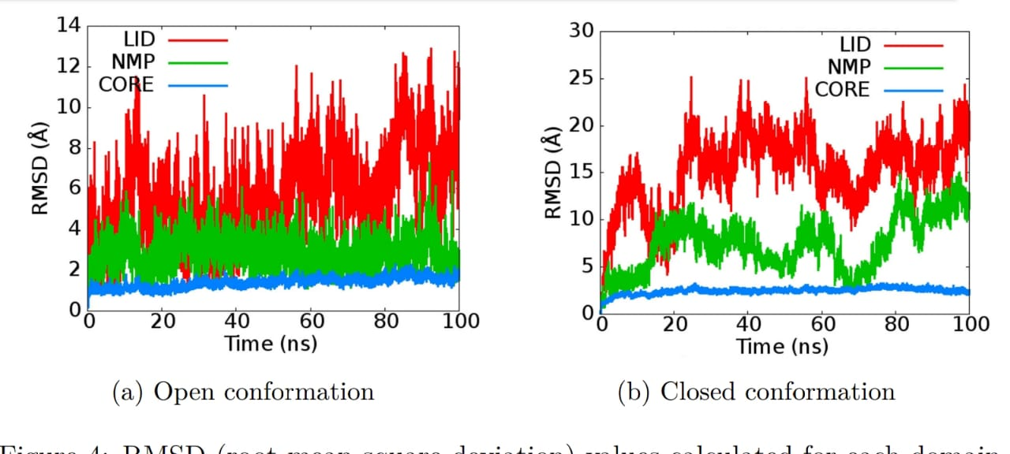
RMSD Plots from MD simulations
(a) Open conformation
(a) Closed conformation
RMSD values calculated for each domain of AK in
Open conformation
Closed conformation

Slide 10
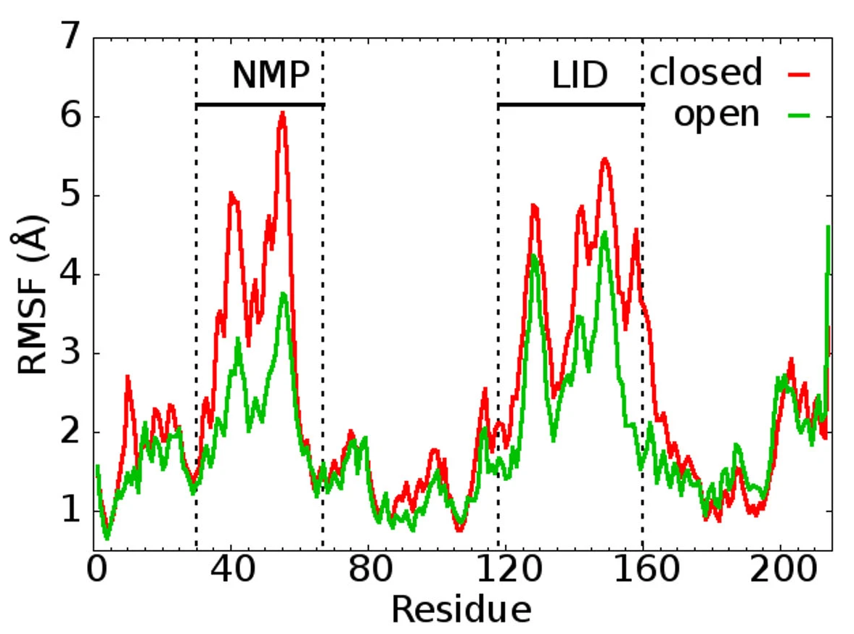
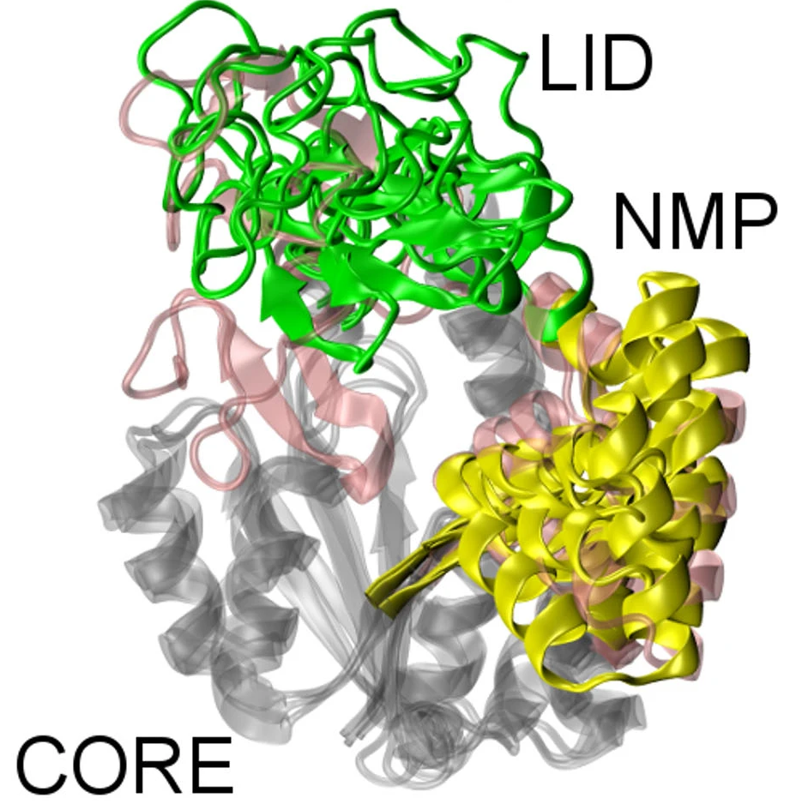
RMSF and Superimposition Plots from MD simulations
(a) RMSF Plot
(a) MD:X-ray superimposition
RMSF of backbone atoms calculated from MD simulation for open and closed AK conformations
Selected MD simulation conformations superimposed over open and closed X-ray states of AK

Slide 11
Assay
and Isoforms
AK Assays
Human AK Isoforms

Slide 12
AK Assay
Introduction
Conventional Assays
Spectrophotometric Assay based on pH
Effect of T and KCl on AK activity

Slide 13

Introduction to Assay
Enzymatic assay is a laboratory technique to study the activity of an enzyme, and factors affecting it.
For a simple reaction, $S⇌P$
$$EA\left(enzyme activity\right)=−\frac{dN_{s }}{dt}=r ×V$$
where
N_{s} : number of moles of substrate
V : reaction volume
r : rate of forward reaction
SI unit : 1 katal = 1 mol/s
Conventional unit : 1 enzyme unit (1 U) = 1 $μmol/\min{=}16.67 nano katals$

Slide 14

Conventional Assays (Coupled Reactions)
For the reaction: $ADP+ADP ⇋ AMP+ATP$
By coupling the reaction with hexokinase and glucose – 6 – phosphate dehydrogenase (G-6-P-DH), in which the final product NADPH is measured spectrophotometrically at 340 nm.
$$ATP+Glucose \underset{→}{hexokinase} Glucose−6−phosphate+ADP+ H^{+}$$
$Glucose−6−phosphate+NADP \underset{→}{G−6−P−DH} 6−phosphogluconic acid+NADPH$
For the reaction in reverse direction, $ATP+AMP ⇋ ADP+ADP$
By coupling the reaction with pyruvate kinase and lactate dehydrogenase, measuring the oxidation of NADH at 340 nm spectrophotometrically, Ak activity can be analysed.
$$ADP+PEP \underset{→}{Pyruvate Kinase} ATP+Pyruvate$$
$Pyruvate +NADH+ H^{+} \underset{→}{Lactate dehydrogenase} Lactate + {NAD}^{+}$
But, coupling method has some limitations, viz. multi-step process, prone to error in each step, can’t analyse the effect of activator and inhibitors on AK activity in presence of other enzyme.

Slide 15
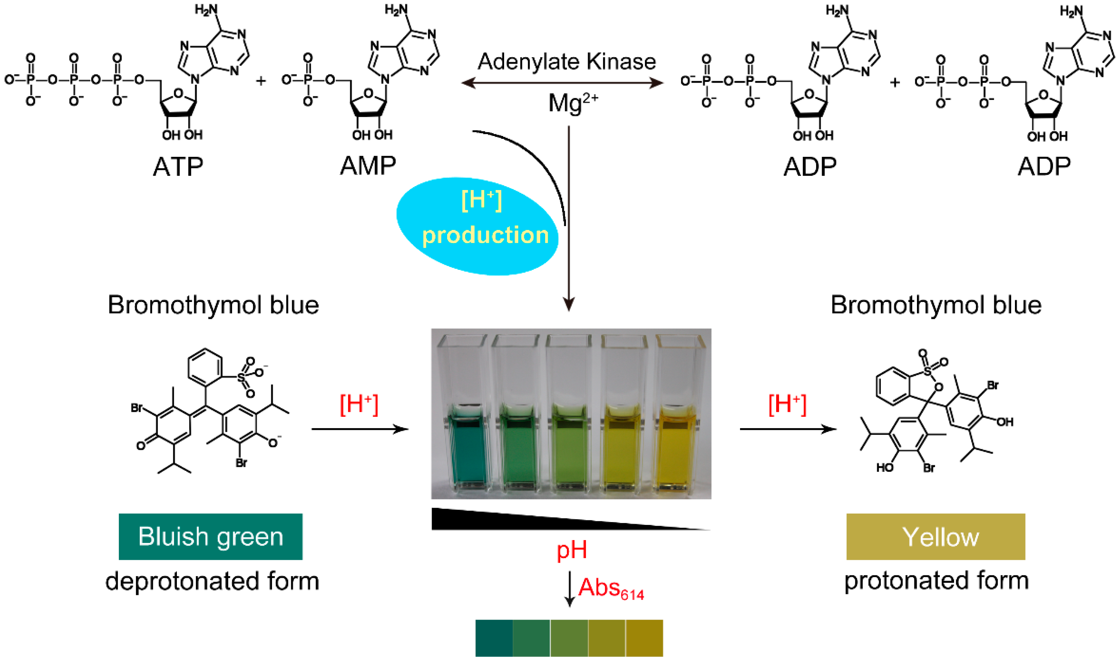

Spectrophotometric Assay (based on pH)
In a AK catalysed reaction, a proton is released when two ADP produced from ATP and AMP.
$$ATP+AMP⇌\text{2 }\text{ADP}\text{ +}{ H}^{+}$$
Bromothymol blue (pH range 6 – 7.6) is an excellent pH indicator for this reaction as AK is effective at pH ~ 7.6.
The principle of the spectrophotometric assay for AK activity

Slide 16
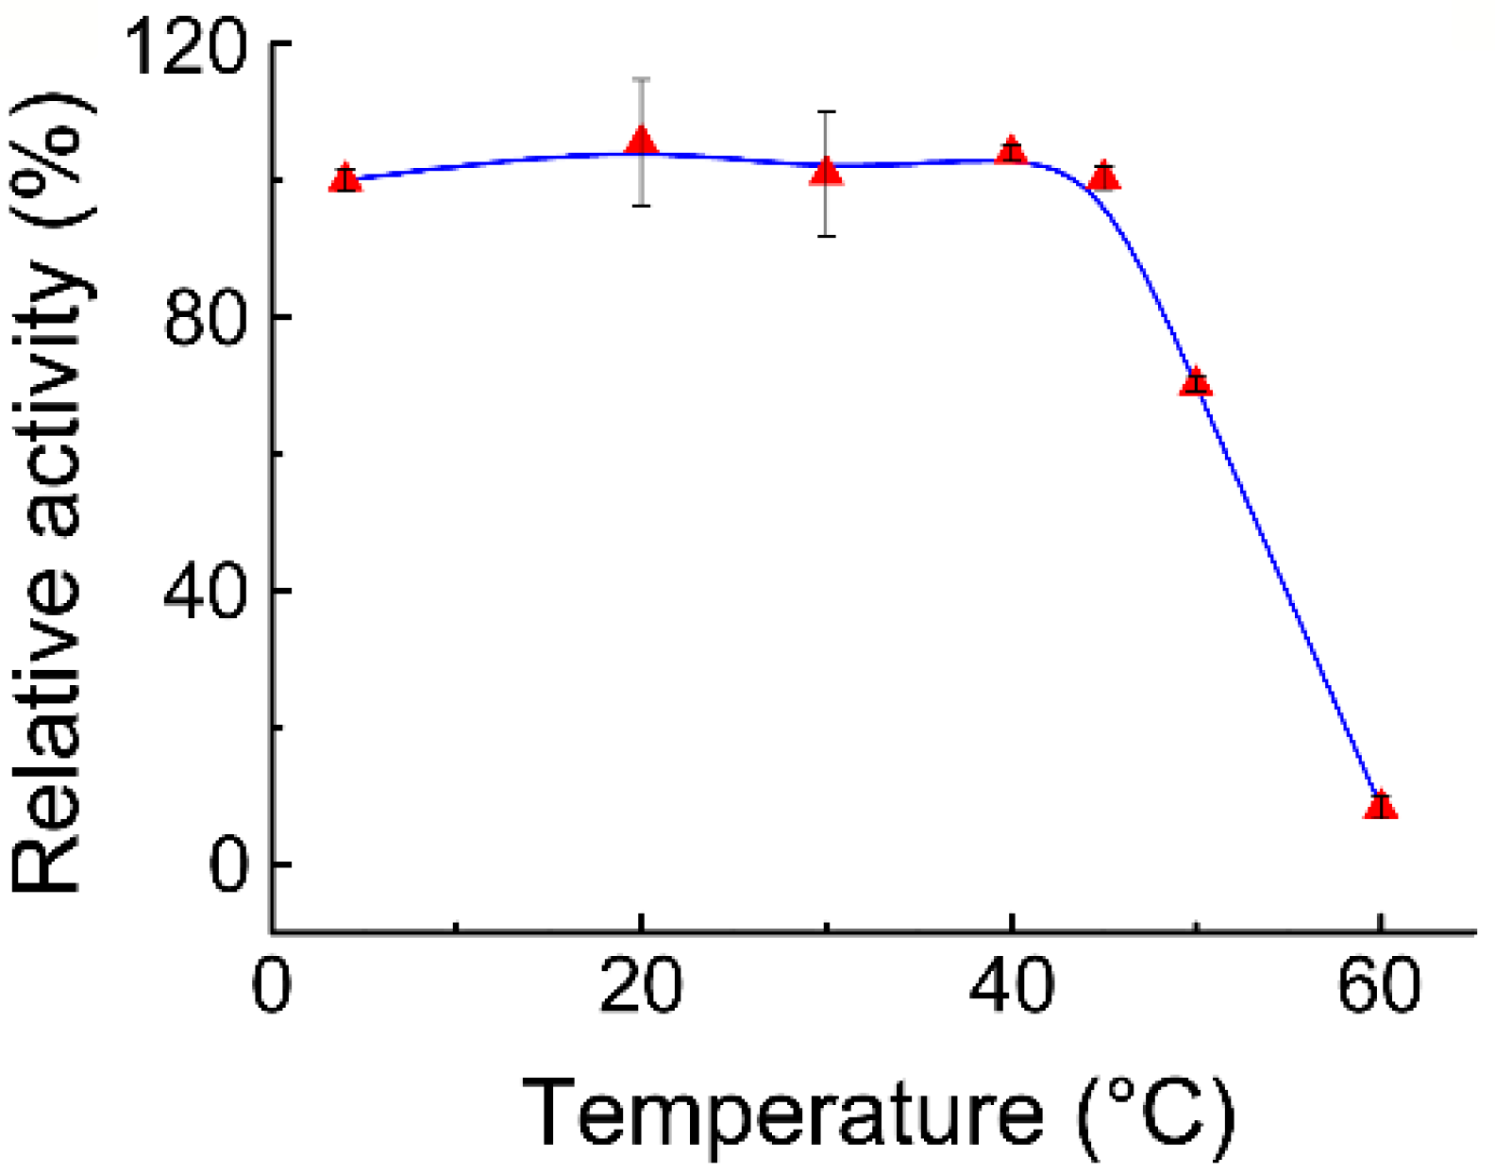
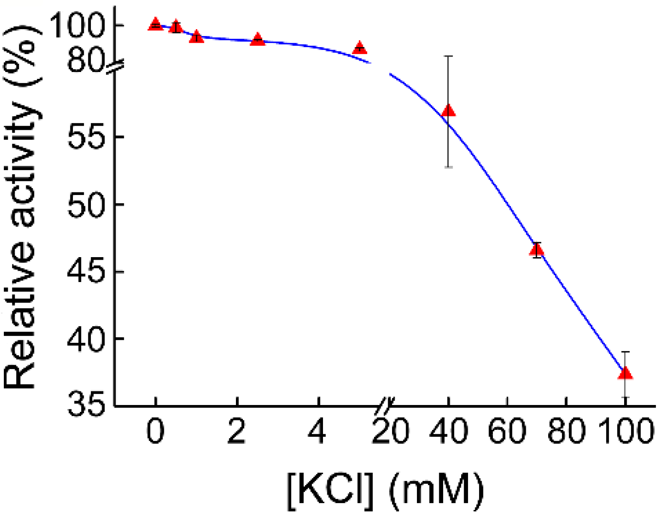
Thermostability and Effect of KCl on AK activity
(a)
(b)
Effect of T: AK is thermally stable up to 40° 𝐶 and completely denatured at 60° C
Effect of KCl: KCl acts as an inhibitor for AK. The inhibitory effect is low at lower concentration. The assay suggests that 70 mM KCl reduces AK activity to almost 50%.

Slide 17
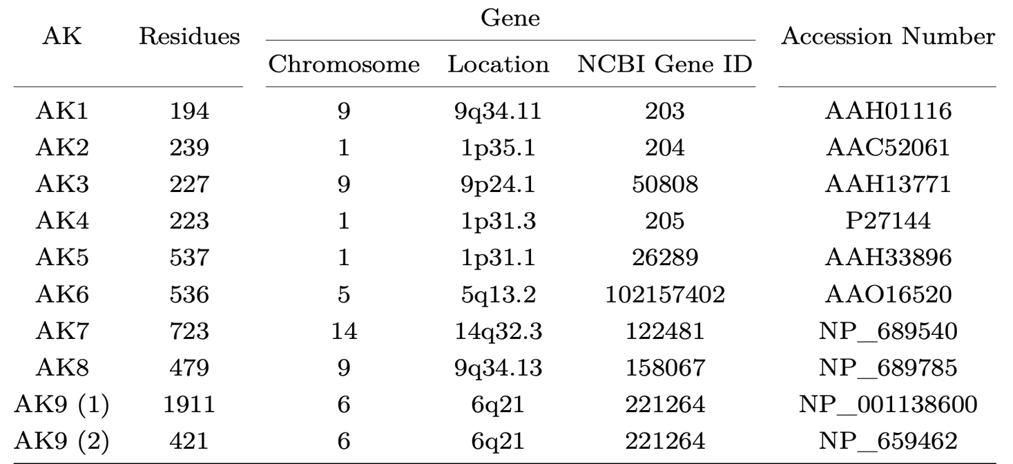
AK Isoforms in Humans
Residues, Genes and Database Identifiers of human AK isoforms
In human, 9 isoforms of AK has been discovered and analysed so far. They are named in the chronological order of their discovery from AK1 to AK9. They differ in their amino acid residues, subcellular location, tissue distribution, selectivity towards phosphate donor and substrate, enzymatic kinetics and therapeutic implications of dysfunction.

Slide 18
Human AK Isoforms
AK | Phosphate donor | Substrate | Subcellular location | Tissue distribution
AK1 | All NTPs | AMP, dAMP | Cytosol | All tissues
AK2 | All NTPs | AMP | Mitochondria (intermembrane space) | Liver, heart, skeletal muscle, kidney, lung
AK3 | GTP, ITP | AMP | Mitochondria (matrix) | Liver, heart, skeletal muscle, kidney
AK4 | ATP, GTP | AMP, dAMP, CMP, dCMP | Mitochondria (matrix) | Liver, heart, brain, kidney
AK5 | ATP, GTP | AMP, dAMP, CMP, dCMP | Cytosol/nucleus | Brain
AK6 | All NTPs and dNTPs | AMP, dAMP, CMP, dCMP | Nucleus | All tissues
AK7 | ATP | AMP, dAMP, CMP, dCMP | Cytosol | Lung, trachea, testis, mammary gland, skeletal muscle
 | GTP | AMP, CMP, dCMP
AK8 | ATP | AMP, dAMP, CMP, dCMP | Cytosol | Liver, pancreas, lung, trachea, testis
 | GTP | AMP, CMP, dCMP
AK9 | ATP | AMP, dAMP, CMP, dCMP | Cytosol /nucleus | Pituitary gland, trachea, thymus, testis, mammary gland, brain, pharynx, uterus, spleen, lymph nodes
Subcellular location, Tissue distribution, Phosphate donor and Substrate specificity of human AK isoforms

Slide 19
Functions
AK Shuttle
Nucleoside Diphosphate Kinases
Purine Nucleotides Synthesis
Nucleoside Analogues

Slide 20
AK Shuttle
Mechanism
Bucket Brigade

Slide 21
Mechanism of AK Shuttle
Within the human cells, AK is present in 2 major isoforms which regulates the use of high energy phosphoryl's of ATP.
AK1
AK2
Cytosolic AK
Mitochondrial Intermembrane AK
AK1 shuttles ATP to the site of high energy consumption
ATPase hydrolyses ATP to produce energy and ADP as by product
AK1 in cytosol converts ADP to ATP and AMP
AMP signals AK2 to produce ADP at the inner membrane (i.m) of mitochondria
ATP-synthase in mitochondria uses ADP to produce ATP at inner membrane

Slide 22
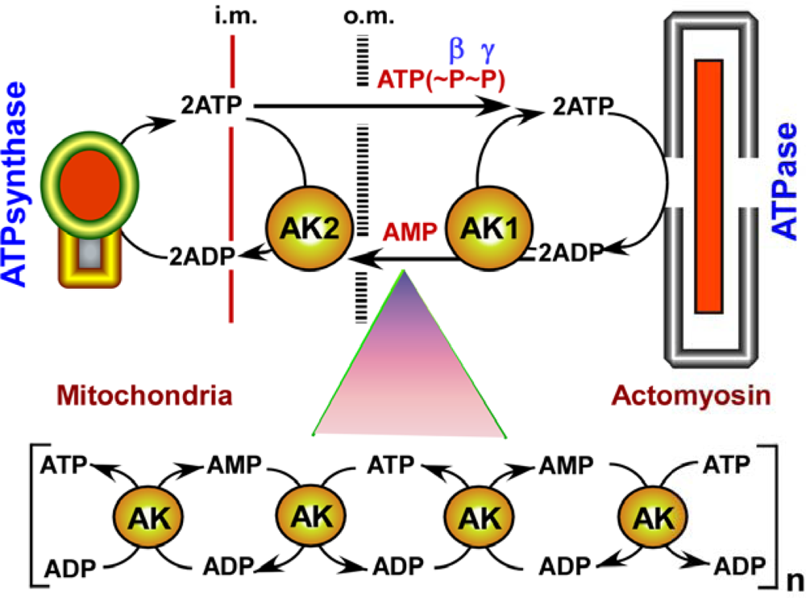
AK Shuttle
Transfer of high energy β and γ phosphoryls of ATP from production to consumption site via ATP shuttle.
i.m : inner membrane, o.m : outer membrane (Petras Dzeja and Andre Terzic, 2009)

Slide 23

Bucket Brigade in AK Shuttle
The intracellular transfer of ATP and AMP from energy production to consumption site (and reverse) may involve multiple phosphotransfer stages in a sequential manner (like a sequential relay).
This results in propagation of ATP-AMP flux (or metabolic flux) through a series of AK molecules, known as “bucket-brigade”
This type of conduction may change local metabolic flux without any apparent change in global metabolic concentration of the cell.
This whole process is crucial for overall energy homeostasis of the cell.

Slide 24
NDPKs (Nucleoside Diphosphate Kinases)
Introduction
Mechanism
AK as NDPKs

Slide 25
Introduction to NDPKs
NDPKs are enzymes that catalyze the reversible phosphoryl transfer from a donor to nucleoside diphosphate (NDP) substrate, producing corresponding nucleoside triphosphate (NTP).
NDPK
Donor (d)
Substrate (s)
NTP_{(d)} + NDP_{(s)}
NDP_{(d)} + NTP_{(s)}
Family of genes that encode NDPKs are called nm23. So far, ten such genes have been identified in humans and are designated nm23-H1 to nm23-H9, with the last gene known as RP2.
NDPKs are shown to play an important role in many biological processes such as protein synthesis, metabolic signaling, cellular development, proliferation, differentiation and apoptosis.
The two major features that differentiates NDPKs from nucleoside kinases (NKs) and nucleoside monophosphate kinases (NMPKs) involved in NTP (or dNTP) synthesis are
NDPKs do not have a p-loop motif in phosphate donor binding site.
NDPKs are not specific to any particular substrate. They can accept pyrimidine and purine, ribo and deoxyribo nucleoside diphosphates as substrates.

Slide 26
Mechanism of NDPKs
NDPKs follow a ping-pong mechanism with the following scheme…
Phosphate donor NTP_{(d)} binds with NDPK and transfers γ-phosphate to histidine residue of the enzyme resulting in high energy NDPK-His-P phosphoenzyme intermediate.
NDP_{(d)} detaches from the enzyme which triggers conformational change that facilitates the binding of substrate NDP_{(s)} (or dNDP_{(s)}) to the phosphoenzyme intermediate.
Transfer of phosphoryl group from NDPK-His-P to the NDP_{(s)} (or dNDP_{(s)}) results in product NTP_{(s)} (or dNTP_{(s)})
Product is released, resulting in enzyme back to its initial open conformation.

Slide 27
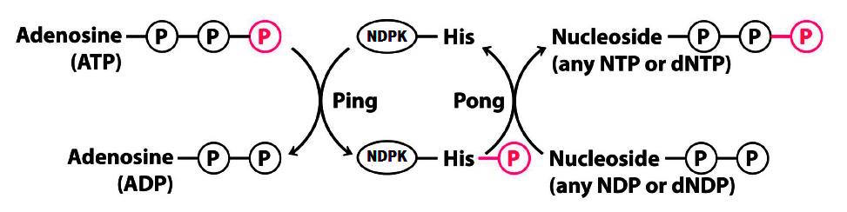
NDPK Mechanism
NTP_{(d)}
NDP_{(d)}
NDP_{(s)}
NTP_{(s)}
NTP_{(d)}
NDP_{(d)}
(a)
NDPK
NDPK-His-P
NDPK
Ping
Pong
(b)
Ping-Pong mechanism followed by NDPKs for the phosphorylation of NDP (or dNDP) substrate
General scheme
Catalytic loop with ATP as phosphate donor (D.L. Nelson, 2004)

Slide 28
AK as NDPKs
In addition to NMPK activity, AK9 also shows NDPK activity. Substrate specificity slightly varies in order: CDP > UDP > ADP > GDP > TDP irrespective of the phosphate donor.
Likewise, other human AK isoenzymes can also convert majority of NDPs and dNDPs to corresponding NTPs and dNTPs.
Some AK shows restricted NDP binding ability. For ex, AK8 cannot phosphorylate UDP with ATP as phosphate donor. Using alternate donor (such as GTP) can bypass this problem.
AKs are highly selective towards NMPs (NMPK activity), but have significantly lower selectively towards NDPs (NDPK activity). This is because AK active sites are optimized for NMPs. NDPs do not fit well in those sites and can easily attack γ-phosphoryl group of the donor molecule.
Deficiency of NDPKs can be compensated by the presence of NMPKs such as AK. This is shown in case of bacteria, Ureaplasma parvum that lacks NDPK gene. Mutated Escherichia coli with disrupted NDPK activity when injected with AK from Ureaplasma parvum showed renewed NDPK activity.
AK
NDP (or dNDP)
NTP (or dNTP)

Slide 29
Intracellular Synthesis of Purine Nucleotides
Importance of Nucleotides
The De-novo Pathway
The Salvage Pathway

Slide 30
Importance of Nucleotides
Nucleic Acids
Energy Carriers
RNA and DNA are polymers of ribo- and deoxyribo-nucleotides.
Coenzymes FAD, NAD and CoA are derivates of adenine nucleotide, which play important role in e⁻, H⁻ and acyl group transfer reactions.
ATP, NADH and FADH2 are primary energy carriers of the cell.
ATP acts as a high-energy phosphate donor and as driving force for oxidative phosphorylation.
Metabolic Signaling
AMP and cAMP level changes in response to various chemical, physiological and hormonal stimuli.
Regulates many enzymes (kinases like AK2), genetic expressions, K⁺ and Ca⁺² channels with AMP/cAMP receptors, metabolic processes such as glycogenesis and glycogenolysis.

Slide 31
Pharmacology
Blood coagulation via platelet aggregation is greatly affected by intracellular ADP levels. Drugs targeting ADP can treat blood clotting disorders such as Hemophilia.
Nucleoside analogues resemble natural nucleosides and depend on intracellular phosphorylation for their activation. Useful in viral infections, cancer and other auto-immune diseases.
Nucleotides must be produced within the cell
Purine nucleotide synthetic pathways
1. De-novo pathway
Chemical synthesis of complex molecules from simple ones
2. Negatively charged phosphate groups resists diffusion across the phospholipid membrane
1. Cell membrane does not contain any nucleotide carrier protein
2. Salvage pathway
Uses left over intermediates and by-products from other destructive processes of similar molecule

Slide 32
The de-novo Pathway
Major source of DNA transcription and replication in developing cells. Steps involved are
Formation of IMP (precursor for AMP and GMP) using simple molecules: PRPP as the source of ribose 5’-phosphate, amino acids, CO2 and N10-formyltetrahydrofolate.
AMP and GMP are phosphorylated to ADP and GDP by AK and GUK respectively.
ADP and GDP can be
phosphorylated by NDPKs to ATP and GTP.
reduced by Ribonucleoside Reductase (RNR) to deoxyribo forms: dADP, dGDP. Phosphorylation gives dATP and dGTP.

Slide 33

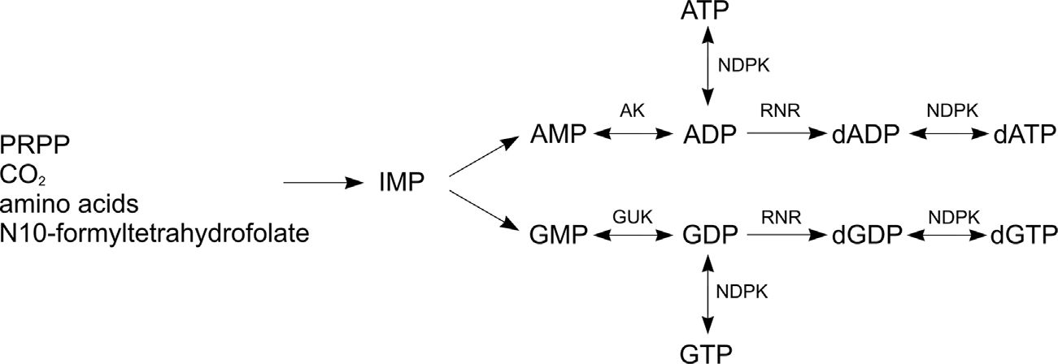

The de-novo Pathway
(c) De-novo pathway
(a) 5’-Phosphoribosyl Pyrophosphate (PRPP)
(b) Inosine Monophosphate (IMP)
Synthesis of purine nucleotides inside a mammalian cell

Slide 34
The salvage Pathway
Essential for DNA repair, replication and transcription in damaged cells. It uses nucleotides left as by products of RNA and DNA degradation as nucleoside precursors after dephosphorylation.
If nucleoside precursors are outside the cell, they are either actively transported or passively diffused across the cell membrane via nucleoside carrier proteins.
Inside the cell, NKs phosphorylate nucleosides to NMP and dNMP.
NDP can be
phosphorylated by NDPKs to NTP.
reduced by Ribonucleoside Reductase (RNR) to dNDP. Subsequent phosphorylation by NDPKs gives dNTP.
NMP (and dNMP) are phosphorylated to NDP (and dNDP) by NMPKs such as AK.

Slide 35
The salvage pathway
Nucleosides
(can be outside cell)
dephosphorylation
Nucleotides
(nucleoside precursors)
degradation
RNA / DNA
Active/Passive Transport
NTP
NDPK
Nucleosides
(inside cell)
NK
NMPK
NMP
NDP
RNR
NDPK
dNDP
dNTP
Synthesis of purine nucleotides inside a mammalian cell

Slide 36
Nucleoside Analogues (NAs)
Introduction
Mechanism
Examples

Slide 37
Introduction to NAs
Definition
NAs are a class of novel drugs that resemble the structure of natural nucleosides.
Treatment of viral infections (influenza, hepatitis B and C, HIV, herpes etc).
Within the cell, activated NAs mimic natural nucleotides (building blocks of DNA and RNA).
Against malignant diseases (leukaemia, lung cancer, solid tumors) and other autoimmune diseases.
Usage
NAs are used as cytotoxins (ability to kill cells)
Side Effects
Due to cytotoxicity and incorporation of NAs in nucleic acids, long term usage can cause disorders similar to genetic mutations in DNA and mtDNA.
Multi-organ disorders such as lactic acidosis, neuropathy, cardiomyopathy, and organ (liver, bone marrow, pancreas) failure.

Slide 38
Mechanism of NAs
Administration
Cellular Transport
Intracellular Activation
Incorporation to DNA
Administration
NAs are administered as monophosphates to increase their solubility.
Transport into cell
Before entering the cell, they are dephosphorylated back to nucleoside by nucleotidases.
NAs are usually hydrophilic, and require special Nucleoside Carrier Proteins (NCPs)
Intramembrane concentration and tissue distribution of NCPs controls sensitivity towards NAs.
Incorporation into DNA
After activation to NTPs, NAs are incorporated into DNA and RNA of the viral or malignant cells.
Intracellular Activation to NTPs
Sequential action of NKs, NMPKs and NDPKs. First step is rate-limiting.
Driven by the action of nucleic acid synthesis, replication and repair mechanisms
Irreparable DNA mutation causes cell apoptosis

Slide 39
Mechanism of NAs
(a)
nucleotidases
(dephosphorylation)
nucleoside carrier proteins
NAMP
(NA Monophosphate)
NA
(outside cell)
NA
(inside cell)
(sensitivity limiting)
incorporation into DNA
NTP
(only 5’ OH)
DNA
chain termination
(b)
NDPK
NA
(inside cell)
NK
NMPK
nucleotidases
NMP
NDP
incorporation into DNA
(rate limiting)
NDPK
NTP
(3’ and 5’ OH)
DNA
chain insertion
Administration and Transport into cell
Intracellular activation and Incorporation into DNA

Slide 40



Examples of Nucleoside Analogues
(a)
(b)
(c)
Cladribine (CdA)
2-Chloro, 2-deoxy-Adenosine
Fludarabine (FaraA)
2-Fluoro, 9-β-arabinofuranosyl-Adenine
Gemcitabine (dFdC)
2’,2’-Difluorodeoxycytidine
Cladribine (CdA): analogue of deoxy-Adenosine (dAdo)
Fludarabine (FaraA): analogue of Adenosine (Ado)
Gemcitabine (dFdC): analogue of deoxy-Cytidine (dCyd)

Slide 41
Conclusion
AKs are the only intracellular enzyme that can catalyze the interconversion of various adenine nucleotides, essential for nucleic acid synthesis and repair, cellular energy metabolism and homeostasis.
Structure
AK is composed of 3 domains: CORE, LID and NMP
CORE: contains the active site, highly conserved, conformationally stable
LID and NMP: binding sites for phosphate donor and substrate, highly flexible, significant conformation changes
MD simulations are useful in tracking the structure and thermodynamics of various conformations acquired by AK during the phosphoryl transfer
Assays
Various assays have been developed to measure AK activity. Conventional assays use coupled enzymatic reactions.
Spectrophotometric assays employing pH based indicators provide one-step method for sensitive, continuous and real time monitoring of AK activity

Slide 42
Isoforms
Nine human AK isoforms have been identified so far, which differ in substrate and phosphate donor specificity, enzyme kinetics, subcellular localization, tissue distribution, physiological functions and therapeutic impact
Many AK isoforms indicate its important role in diverse array of cellular processes
Function
AK shuttle: necessary for cellular metabolism and energy homeostasis
Nucleoside mono and di-phosphate kinases (NMPKs and NDPKs)
Intracellular synthesis of purine nucleotides
Impact of Dysfunction
Leads to heart failure, neurodegenerative disorders and malignant diseases (AK1: haemolytic anaemia, AK2: reticular dysgenesis, AK7: primary ciliary dyskinesia)
therapeutic interventions targeting AK activity have potential to treat such diseases. One such example is Nucleoside Analogues
Further studies in AK are therefore crucial to better understand its complex phosphoryl transfer mechanism and role in cellular processes, which can provide insights for the development of novel therapeutic strategies.

Slide 43
References
Panayiotou, C; Solaroli, N; Karlsson, A. The many isoforms of human adenylate kinases. The international journal of biochemistry and cell biology 2014
Formoso, E; Limongelli, V; Parrinello, M. Energetics and structural characterization of the large-scale functional motion of adenylate kinase. Scientific reports 2015
Dzeja, P.; Terzic, A. Adenylate kinase and AMP signaling networks: metabolic monitoring, signal communication and body energy sensing. International journal of molecular sciences 2009
Ionescu, M. I. Adenylate kinase: a ubiquitous enzyme correlated with medical conditions. The Protein Journal 2019
Song, K; Wang, Y. A Convenient, Rapid, Sensitive, and Reliable Spectrophotometric Assay for Adenylate Kinase Activity. Molecules 2019
Chang, H.-Y; Fu, C.-Y. Adenylate Kinase. Encyclopedia of Food Microbiology: Second Edition 2014, 18–23
Stryer, L ; Berg, J; Tymoczko, J. Biochemistry, Fifth Edition; [NCBI bookshelf]; W. H. Freeman: 2002

